Slide 1


2-D Cluster Variation Method
Analytic Results (Equilibrium)
with
Alianna J. Maren, Ph.D.
Verification and Validation
Revised: December 27, 2018

Slide 2

Alianna J. Maren, Ph.D.
Developed foundational AI courses for Northwestern University’s SPS program – Master of Science in Data Science:
MSDS 458: AI & Deep Learning,
MSDS 453: Natural Language Processing
Four patents:
Biologically-based sensor fusion
Knowledge discovery
Predictive analytics
Evidence-based reasoning
Recent publications:
Brain Sciences
arXiv
Links to all at:
www.aliannajmaren.com

Slide 3
The Cluster Variation Method:
Takes into account local configuration variables
A Single Zigzag Chain
Showing the Configuration Variables x_{i}, y_{i}, w_{i}, and z_{i}
The Set of Configuration Variables
x_{i}: individual nodes
y_{i}: nearest-neighbors,
w_{i}: next-nearest neighbors, and
z_{i}: triplets

Slide 4
Overview of this slidedeck:
Introducing the 1-D and 2-D Cluster Variation Method notions:
Configuration variables, and
Illustrative base patterns for each case
Analytic results (equilibrium cases)
Validation of code design; corollary document to code verification and validation documentation

Slide 5


1-D Grid Base Pattern:
Configuration Variable Values when h = 1
The Base Pattern is designed to:
Illustrate the triplet configuration variables: one of each z_{i}
Code and analytics V&V: Useful when comparing code results with hand-computed
Tutorial role: Illustrate how the CVM thinking works
Envelope configuration: wraparound horizontally only
1-D Case:
Total number of triplets = number of units
Horizontal wrap-around; identical with leftmost units
Legend
Configuration Variable (Triplet) Values Equiprobable when h = 1
z₁ = 0.125
Z₁ = 2
z₂ = 0.125
Z₂ = 2
z_{2var} = 0.125
Z_{2 var} = 2
variant
z₃ = 0.125
Z₃= 2
Unit in state A
Unit in state B
A
A
A
B
A
A
A
B
B
A
A
A
Wrap-around unit in state A
Wrap-around unit in state B
B
z₆ = 0.125
Z₆= 2
B
z₅ = 0.125
Z₅ = 2
A
z₅ = 0.125
Z₅ = 2
variant
A
z₄ = 0.125
Z₄ = 2
B
B
B
A
B
B
B
B
z_{i} = fraction of triplets of type i; Z_{i} = total number of triplets of type i

Slide 6
2-D Grid Base Pattern:
Configuration Variable Values when h = 1
Vertical wrap-around; identical with bottom row
Envelope configuration: wraparounds vertically and horizontally
Total number of triplets = 4*number of units
= 4*(4*8) = 128
Horizontal wrap-around; identical with leftmost units
Legend
Configuration Variable (Triplet) Values Equiprobable when h = 1
z₁ = 0.125
Z₁ = 16
z₂ = 0.125
Z₂ = 16
z_{2var} = 0.125
Z_{2 var} = 16
variant
z₃ = 0.125
Z₃= 16
Unit in state A
Unit in state B
A
A
A
B
A
A
A
B
B
A
A
A
Wrap-around unit in state A
Wrap-around unit in state B
B
z₆ = 0.125
Z₆= 16
B
z₅ = 0.125
Z₅ = 16
A
z₅ = 0.125
Z₅ = 16
variant
A
z₄ = 0.125
Z₄ = 16
B
B
B
A
B
B
B
B
z_{i} = fraction of triplets of type i; Z_{i} = total number of triplets of type i

Slide 7
The 2-D CVM Grid Can Serve as a Hidden Layer in a Computational Engine
External States ₂
Markov Blanket: Active Units (a)
A
B
B
B
A
A
A
A
B
A
Internal States
A
B
B
B
A
Representational units
(r)
A
A
A
B
A
Markov Blanket: Sensing Units (s)
External States ₁

Slide 8
The Configuration Variables:
Visualizing the Configuration Variables
for the Cluster Variation Method (Both 1-D and 2-D)
Visual depiction of how the configuration variables appear in both the 1-D and 2-D CVM grids
Identifying and counting the configuration variables
Depicting a CVM grid: square block and dot depictions

Slide 9
Configuration Variables in the 1-D CVM

Slide 10
The 1-D CVM: Comprised of a Single Zigzag Chain
Showing the Configuration Variables x_{i}, y_{i}, w_{i}, and z_{i}
There are four different kinds of local configuration variables:
x_{i} – the fraction of nodes in their specific activation state
y_{i} – nearest-neighbors
w_{i} – next-nearest-neighbors
z_{i} - triplets
Total numbers of each kind:
x_{i} – two types: A or B (“on” or “off,” respectively)
y_{i} – three types: A-A, A-B (also B-A), and B-B (degeneracy = 2 for A-B / B-A
w_{i} – three types: A--A, A--B (also B--A), and B--B (degeneracy = 2 for A--B / B—A – these occur within the same row for the 1-D case
z_{i} – six types of triplets; two have degeneracies of two each – see next slide

Slide 11
1-D CVM with Two Instances of Base Pattern
Base pattern characteristics:
Requires eight nodes; four A (“on”) and four B (“off”)
Yields one instance of each of the different triplets (including the degenerate types)
Envelope configuration: wraparound horizontally only
1-D CVM:
Total number of triplets = number of units
Horizontal wrap-around; identical with leftmost units
Legend
Configuration Variable (Triplet) Values (Equiprobable when h = 1)
z₁ = 0.125
Z₁ = 2
z₂ = 0.125
Z₂ = 2
z_{2var} = 0.125
Z_{2 var} = 2
variant
z₃ = 0.125
Z₃= 2
Unit in state A
Unit in state B
A
A
A
B
A
A
A
B
B
A
A
A
Wrap-around unit in state A
Wrap-around unit in state B
B
z₆ = 0.125
Z₆= 2
B
z₅ = 0.125
Z₅ = 2
A
z₅ = 0.125
Z₅ = 2
variant
A
z₄ = 0.125
Z₄ = 2
B
B
B
A
B
B
B
B
z_{i} = fraction of triplets of type i; Z_{i} = total number of triplets of type i

Slide 12
Square-Grid-Node Representation vs.
Dot-Grid-Node Representation
for the Same Grid
1-D grid with
two repeats of base pattern
Typical grid representation – easy pattern visualization
Horizontal wrap-around; identical with leftmost units
Dot grid representation – easy to view configuration variables (y, w, and z)
Same pattern in dot-grid representation
Same horizontal wrap-around; identical with leftmost units
The wrap-around on the left-hand-side was useful for structured code

Slide 13
Configuration Variables in the 2-D CVM

Slide 14
Two Different Visualizations of the Same 2-D CVM Grid
(Showing only ONE of the two wrap-arounds on top and right)
Block grid:
Used in most papers & slidedecks
Easiest for visualizing local shapes & patterns
Dot grid:
Used only to show how the different configuration variables are set up
Note: BOTH grid patterns show both horizontal and vertical wrap-arounds; at the top and right-side edges; dark and light mottled grey

Slide 15
The y_{i} Configuration Variables in a 2-D CVM Grid
Four y_{i} nearest-neighbor variables per node are diagonally UP or DOWN with regard to the center node
To compensate for double-counting, we divide by 2. Y = Total number of y_{i} config variables = 2N
(where N = number of nodes in grid)
Col 0
Col 1
Col 2
Col 3
Col 4
Four y_{i} nearest-neighbor variables:
Row 0
One on each diagonal
Separation distance = 1 unit
Degeneracy factor of 2 to account for counting A-B and B-A nearest neighbors differently
Row 1
y_{i}:
Row 2
Row 3
Row 4

Slide 16
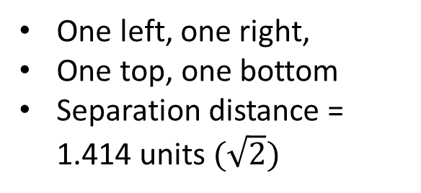
The w_{i} Configuration Variables in a 2-D CVM Grid
Four w_{i} nearest-neighbor variables per node are the two horizontal and two vertical neighbors
To compensate for double-counting, we divide by 2. W = Total number of w_{i} config variables = 2N
(where N = number of nodes in grid)
Col 0
Col 1
Col 2
Col 3
Col 4
Row 0
Four w_{i} next-nearest-neighbor variables:
Row 1
One left, one right,
One top, one bottom
Separation distance = 1.414 units $(\sqrt{2})$
w_{i}:
Row 2
Row 3
Row 4

Slide 17
The Eight z_{i} Configuration Variables per Node in a 2-D CVM Grid
To compensate for double-counting, we divide by 2. Z = Total number of z_{i} config variables = 4N
(where N = number of nodes in grid)
Four horizontal z_{i} configurations
Within two rows and three columns each:
Four z_{i} triplet variables within the rows immediately above and below the central node
Four vertical z_{i} configurations
Within two columns and three rows each:
Four z_{i} triplet variables extend to two rows above and two rows below the central node (two for each direction)

Slide 18
These are NOT z_{i} Configurations
NOT allowable z_{i} configurations:
The z_{i} triplet variables must be in a “bent-angle” configuration, not a straight line.

Slide 19
Illustration of Computing Configuration Variables for a Base Pattern
Base Pattern: 4*8 = 32 nodes
2*32 = 64 total Y configurations
2*32 = 64 total W configurations
4*32 = 128 total Z configurations
Same Base Pattern with horizontal and vertical wrap-arounds:
Two wrap-around rows on top
Two wrap-around columns on right-hand side

Slide 20
2-D Grid: HORIZONTAL Triplet Configuration Variable Values when h = 1
Upwards-facing vertical Z1 triplet
Vertical wrap-around; identical with bottom two rows
Total number of triplets = 4*number of units = 4*32 = 128; equal numbers of each kind of triplet for the base pattern means 128/8 = 16 of each kind of triplet; 8 vertical and 8 horizontal triplet configurations
Downwards-facing vertical Z1 triplet
Envelope configuration: wraparounds vertically and horizontally
Horizontal wrap-around; identical with two leftmost units
Legend
Horizontal Triplet Configuration Variable Values Equiprobable when h = 1
z₁ = 0.125
Z_{1, Hor} = 8
z₂ = 0.125
Z_{2, Hor} = 8
z_{2var} = 0.125
Z_{2, Hor var} = 8
variant
z₃ = 0.125
Z_{3, Hor}= 8
Unit in state A
Unit in state B
A
A
A
B
A
A
A
B
B
A
A
A
Wrap-around unit in state A
Wrap-around unit in state B
B
z₆ = 0.125
Z_{6, Hor}= 8
B
z₅ = 0.125
Z_{5, Hor} = 8
A
z₅ = 0.125
Z_{5, Hor} = 8
variant
A
z₄ = 0.125
Z_{4, Hor} = 8
B
B
B
A
B
B
B
B
z_{i} = fraction of triplets of type i; Z_{i} = total number of triplets of type i

Slide 21
Left-facing vertical Z₁ triplet
2-D VERTICAL Configuration Variable Values when h = 1
Vertical wrap-around; identical with bottom two rows
Right-facing vertical Z₁ triplet
Total number of vertical Z₁ triplets = 8 for this 32-node base pattern (8 horizontal Z₁ triplets shown in previous slide)
Envelope configuration: wraparounds vertically and horizontally
Horizontal wrap-around; identical with two leftmost units
Legend
Vertical Triplet Configuration Variable Values Equiprobable when h = 1
A
z₁ = 0.125
Z_{1, Vert} = 8
z₂ = 0.125
Z_{2, Vert} = 8
z_{2var} = 0.125
Z_{2, Vert var} = 8
variant
z₃ = 0.125
Z_{3, Vert}= 8
Unit in state A
Unit in state B
A
A
A
B
A
A
B
B
A
A
A
Wrap-around unit in state A
Wrap-around unit in state B
B
z₆ = 0.125
Z_{6, Vert}= 8
B
z₅ = 0.125
Z_{5, Vert} = 8
A
z₅ = 0.125
Z_{5, Vert} = 8
variant
A
z₄ = 0.125
Z_{4, Vert} = 8
B
B
B
A
B
B
B
B
z_{i} = fraction of triplets of type i; Z_{i} = total number of triplets of type i

Slide 22
Illustration of Two Different Grid Patterns
in the 2-D CVM
Note: Approximate; Counts only Horizontal Triplets
Illustrates two different grid patterns, both for the case where epsilon0 = 0; meaning x₁ = x₂ = 0.5, or equiprobable distribution among the two states; the two patterns have different h-values:
Scale-free-like pattern, and
Rich club-like pattern
Counts z₁ and z₃ (triplet) configuration variables in each
Validates that the computer code produces the same results as manual
Counts the horizontal triplets only – approximation of total

Slide 23
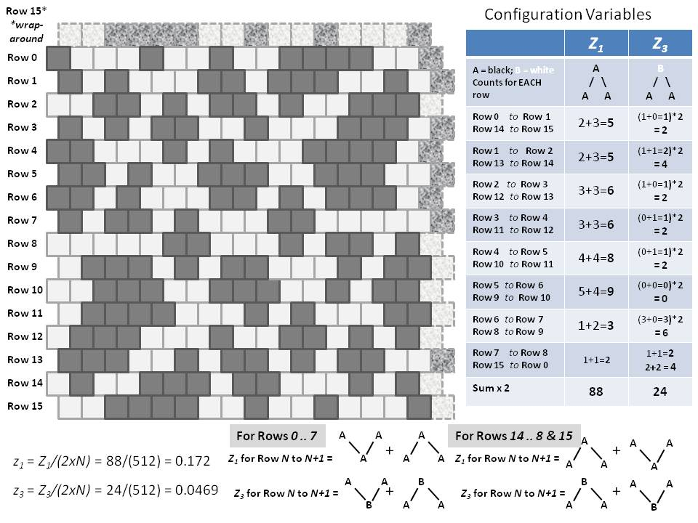
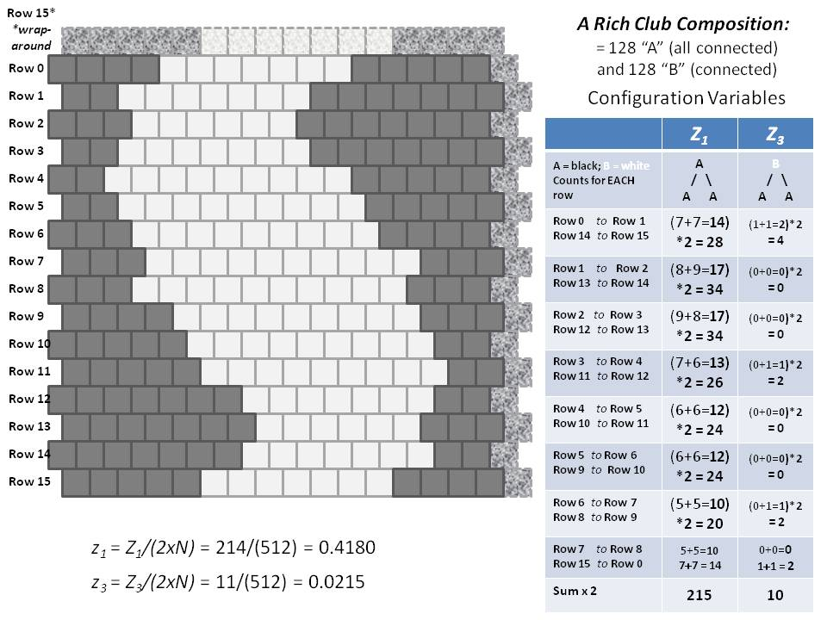
Two Different Configurations for a 2-D CVM Grid
Equiprobable unit distribution (x₁ = x₂ = 0.5)
Each grid contains 256 units (16 x 16)
(a)
Scale-free-like topography
(b)
Extreme rich club-like topography

Slide 24
Row 15*
*wrap-around
A Rich Club-Like Composition:
= 128 “A” (all connected)
and 128 “B” (connected)
Row 0
Configuration Variables
Row 1
Horizontal Triplets | Z₁ | Z₃
A = black; B = white Counts for EACH row | A / \ A A | B / \ A A
Row 0 to Row 1 Row 14 to Row 15 | (7+7=14) *2 = 28 | (1+1=2)*2 = 4
Row 1 to Row 2 Row 13 to Row 14 | (8+9=17) *2 = 34 | (0+0=0)*2 = 0
Row 2 to Row 3 Row 12 to Row 13 | (9+8=17) *2 = 34 | (0+0=0)*2 = 0
Row 3 to Row 4 Row 11 to Row 12 | (7+6=13) *2 = 26 | (0+1=1)*2 = 2
Row 4 to Row 5 Row 10 to Row 11 | (6+6=12) *2 = 24 | (0+0=0)*2 = 0
Row 5 to Row 6 Row 9 to Row 10 | (6+6=12) *2 = 24 | (0+0=0)*2 = 0
Row 6 to Row 7 Row 8 to Row 9 | (5+5=10) *2 = 20 | (0+1=1)*2 = 2
Row 7 to Row 8 Row 15 to Row 0 | 5+5=10 7+7 = 14 | 0+0=0 1+1 = 2
Sum x 2 | 214 | 10
Row 2
Row 3
Row 4
Row 5
Row 6
Row 7
Row 8
Row 9
Row 10
Row 11
Row 12
Row 13
Row 14
Row 15
Illustration based on counting the horizontal triplets only:
z₁ = Z₁/(2xN) = 214/(512) = 0.4180
z₃ = Z₃/(2xN) = 10/(512) = 0.0195

Slide 25
Row 15*
*wrap-around
A Scale-Free-Like Composition
Configuration Variables
Horizontal Triplets | Z₁ | Z₃
A = black; B = white Counts for EACH row | A / \ A A | B / \ A A
Row 0 to Row 1 Row 14 to Row 15 | (2+3=5)*2 = 10 | (1+0=1)*2 = 2
Row 1 to Row 2 Row 13 to Row 14 | (2+3=5)*2 = 10 | (1+1=2)*2 = 4
Row 2 to Row 3 Row 12 to Row 13 | (3+3=6)*2 = 12 | (1+0=1)*2 = 2
Row 3 to Row 4 Row 11 to Row 12 | (3+3=6)*2 = 12 | (0+1=1)*2 = 2
Row 4 to Row 5 Row 10 to Row 11 | (4+4=8)*2 = 16 | (0+1=1)*2 = 2
Row 5 to Row 6 Row 9 to Row 10 | (5+4=9)*2 = 18 | (0+0=0)*2 = 0
Row 6 to Row 7 Row 8 to Row 9 | (1+2=3)*2 = 6 | (3+0=3)*2 = 6
Row 7 to Row 8 Row 15 to Row 0 | (1+1=2)*2 = 4 | 1+1=2 2+2 = 4
Sum | 88 | 24
Row 0
Row 1
Row 2
Row 3
Row 4
Row 5
Row 6
Row 7
Row 8
Row 9
Row 10
Row 11
Row 12
Row 13
Row 14
Row 15
For Rows 0 .. 7
A
A
A
For Rows 14 .. 8 & 15
A
A
A
+
+
z₁ = Z₁/(2xN) = 88/(512) = 0.172
Z₁ for Row N to N+1 =
A
A
A
Z₁ for Row N to N+1 =
A
A
A
z₃ = Z₃/(2xN) = 22/(512) = 0.0430
A
A
B
B
A
A
Z₃ for Row N to N+1 =
+
Z₃ for Row N to N+1 =
+
B
A
A
A
A
B

Slide 26
Details of Counting Horizontal Triplets for the Two Different Grid Configurations
Rich Club-Like Topography
Scale-Free-Like Topography
Horizontal Triplets | Z₁ | Z₃
A = black; B = white Counts for EACH row | A / \ A A | B / \ A A
Row 0 to Row 1 Row 14 to Row 15 | (7+7=14) *2 = 28 | (1+1=2)*2 = 4
Row 1 to Row 2 Row 13 to Row 14 | (8+9=17) *2 = 34 | (0+0=0)*2 = 0
Row 2 to Row 3 Row 12 to Row 13 | (9+8=17) *2 = 34 | (0+0=0)*2 = 0
Row 3 to Row 4 Row 11 to Row 12 | (7+6=13) *2 = 26 | (0+1=1)*2 = 2
Row 4 to Row 5 Row 10 to Row 11 | (6+6=12) *2 = 24 | (0+0=0)*2 = 0
Row 5 to Row 6 Row 9 to Row 10 | (6+6=12) *2 = 24 | (0+0=0)*2 = 0
Row 6 to Row 7 Row 8 to Row 9 | (5+5=10) *2 = 20 | (0+1=1)*2 = 2
Row 7 to Row 8 Row 15 to Row 0 | 5+5=10 7+7 = 14 | 0+0=0 1+1 = 2
Sum x 2 | 214 | 10
Horizontal Triplets | Z₁ | Z₃
A = black; B = white Counts for EACH row | A / \ A A | B / \ A A
Row 0 to Row 1 Row 14 to Row 15 | 2+3=5 *2 = 10 | (1+0=1)*2 = 2
Row 1 to Row 2 Row 13 to Row 14 | 2+3=5 *2 = 10 | (1+1=2)*2 = 4
Row 2 to Row 3 Row 12 to Row 13 | 3+3=6 *2 = 12 | (1+0=1)*2 = 2
Row 3 to Row 4 Row 11 to Row 12 | 3+3=6 *2 = 12 | (0+1=1)*2 = 2
Row 4 to Row 5 Row 10 to Row 11 | 4+4=8 *2 = 16 | (0+1=1)*2 = 2
Row 5 to Row 6 Row 9 to Row 10 | 5+4=9 *2 = 18 | (0+0=0)*2 = 0
Row 6 to Row 7 Row 8 to Row 9 | 1+2=3 *2 = 6 | (3+0=3)*2 = 6
Row 7 to Row 8 Row 15 to Row 0 | 1+1=2 *2 = 4 | 1+1=2 2+2 = 4
Sum x 2 | 88 | 24

Slide 27
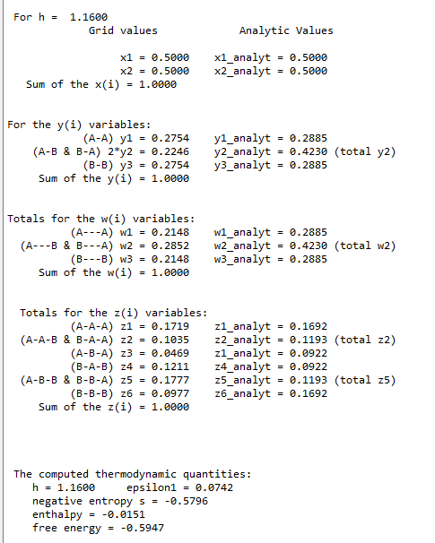
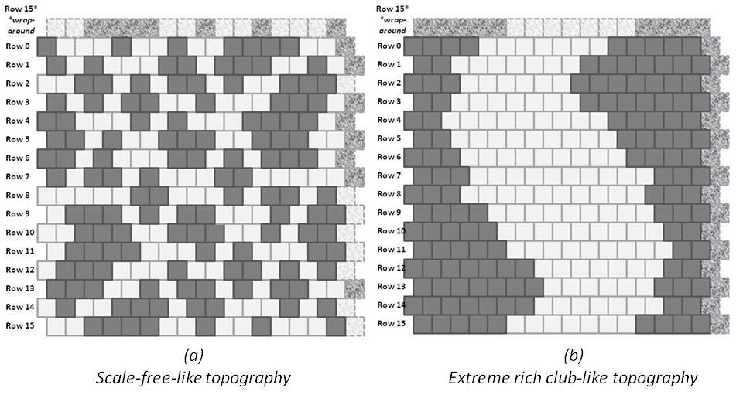
A Scale-Free-Like Composition: Code Validation
z₁ = Z₁/(2xN) = 88/(512) = 0.172
z₃ = Z₃/(2xN) = 24/(512) = 0.0469
Hand-counted z₁ and z₃ values:
Code validation step
Approximate h-value: 1.16
NOTE: Hand-crafted pattern has unequal values for z₁ & z₆, etc., so the h-value can only be approximate; the pattern is not an equilibrium one.
Program: 2D-CVM_defined-patterns_analytic-solution_2017-12-08_rev_2018-11-22.py
Run Date: 11/23/2018 Private GitHub: 2-D-CVM-Random-Pattern-Configurations

Slide 28
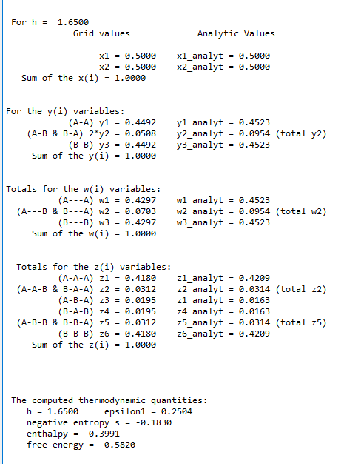
An Extreme Rich Club-Like Composition: Code Validation
z₁ = Z₁/(2xN) = 214/(512) = 0.4180
z₃ = Z₃/(2xN) = 10/(512) = 0.0195
Hand-counted z₁ and z₃ values:
Code validation step
Approximate h-value: 1.65
NOTE: Hand-crafted pattern has equal values for z₁ & z₆, etc., so the h-value corresponds to the hand-counts. However: the analytic solution diverges as h gets larger.
Program: 2D-CVM_defined-patterns_analytic-solution_2017-12-08_rev_2018-11-22.py
Run Date: 11/23/2018 Private GitHub: 2-D-CVM-Random-Pattern-Configurations

Slide 29
Two Extremely Different Topographies Give the Range of Useful h-values
(a)
Scale-free-like topography
(b)
Extreme rich club-like topography
Approximate h-value: 1.16
Approximate h-value: 1.65

Slide 30
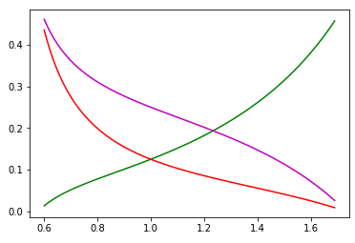
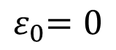
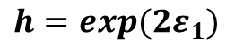
We Can Obtain Analytic Results for Certain Cases
Analytic Values for Configuration Variables y₂, z₁, and z₃
Case where activation enthalpy : x₁ = x₂ = 0.5
$${ ε}_{0}=0$$
B
A
A
y₂
Z₃:
Z₁:
y₂:
B
B
A
A
A
A
A
z₁
Configuration variable
z₃
y₂
z₁
h = 1 (ε₁ = 0)
For h = 1:
z₃
y₂ = 0.250
z₁ = 0.125
z₃ = 0.125
h: interaction enthalpy parameter;
$${ h=exp(2ε}_{1})$$

Slide 31
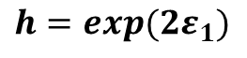
Analytic Values for Configuration Variables y₂, z₁, and z₃
Scale-Free-Like
Extreme Rich Club-Like and Scale-Free-Like Patterns
B
A
A
For h = 1.16:
Z₃:
Z₁:
y₂:
B
B
A
A
A
A
y₂ = 0.212
A
z₁ = 0.169
Configuration variable
y₂
Scale-Free-Like
z₃ = 0.092
h = 1.16
(ε₁ = 0.074)
z₃
Rich Club-Like
Rich Club-Like
h = 1.65
(ε₁ = 0.250)
z₁
For h = 1.65:
y₂ = 0.047
z₁ = 0.418
Approximate Useful Range for h
z₃ = 0.020
h: interaction enthalpy parameter;
$${ h=exp(2ε}_{1})$$

Slide 32
Quick Test to Confirm that the Analytically-Predicted x₁ Yielding Minimal Free Energy is What It Should Be
Program Used:
2D-CVM-simple-eq_no-interaction-calc_v2_2018-10-27.py

Slide 33
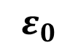
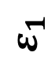
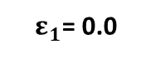
The First Point in the Phase Space: eps0 = eps1 = 0.0
For the case where epsilon1 = 0 (no interaction enthalpy), we are working across the top axis of this graph.
We solve for each value of x1 computationally, as a result of setting the derivative of the free energy equal to zero for a given value of the activation enthalpy eps0.
$${ ε}_{0}$$
(Activation Enthalpy Parameter)
0.0
1.0
2.0
3.0
4.0
5.0
x₁
0.500
0.269
0.119
0.047
0.018
0.007
0.0
0.1
0.500
For eps0 = 0.0 and h = 1.0:
${ ε}_{1}$= 0.0
x₁ = 0.50; FE = -0.6931
0.2
0.500
When both enthalpy parameters, eps0 and eps1, are zero, then the free energy is equal to the negative entropy.
negS = FE = -0.6931
(Interaction Enthalpy Parameter)
0.3
0.500
0.4
0.500
$${ ε}_{1}$$
0.5
0.500

Slide 34
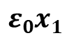
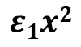
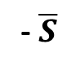
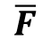
Analytic Run: Compute free energy
General Approach
When the interaction enthalpy eps1 = 0, we should obtain the x₁ for which the free energy is a minimum by setting the derivative of the free energy equation equal to zero, and solving for a given value of eps0.
Just as a confirmation, it is useful to visualize the enthalpy and entropy values for that value of eps0.
We compute: Free energy minimum for different values for different values of x1 (eps0 = 0.1)
x₁
- $\overline{S}$
$$ε0x1$$
$$ε1x2$$
$$\overline{F}$$
Note that the following run has eps1=0, thus eps1*x^2 = 0, for all values of x1.
Code: 2D-CVM-simple-eq_no-interaction-calc_v3_2018-10-30.py
Note: Substitute the particular appropriate epsilon0 value for the value of epsilon0 (see column, LHS, into the program (line 441) to obtain the desired free energy and other thermodynamic results.

Slide 35
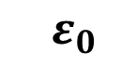
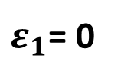
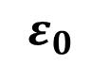
Analytic Values for Active Nodes x₁
Interaction enthalpy is zero:
${ ε}_{1}$= 0
By taking the derivative of the free energy function, we can find the equilibrium value for x₁ at different activation enthalpies
$${ ε}_{0}$$
0.5
x₁ vs (Activation Enthalpy Parameter)
0.4
x₁
0.3
0.2
0.1
0.0
0.0
1.0
0.2
3.0
4.0
5.0
(Activation Enthalpy Parameter)
$${ ε}_{0}$$
Code: 2D-CVM-simple-eq_no-interaction-calc_v3_2018-10-30.py

Slide 36
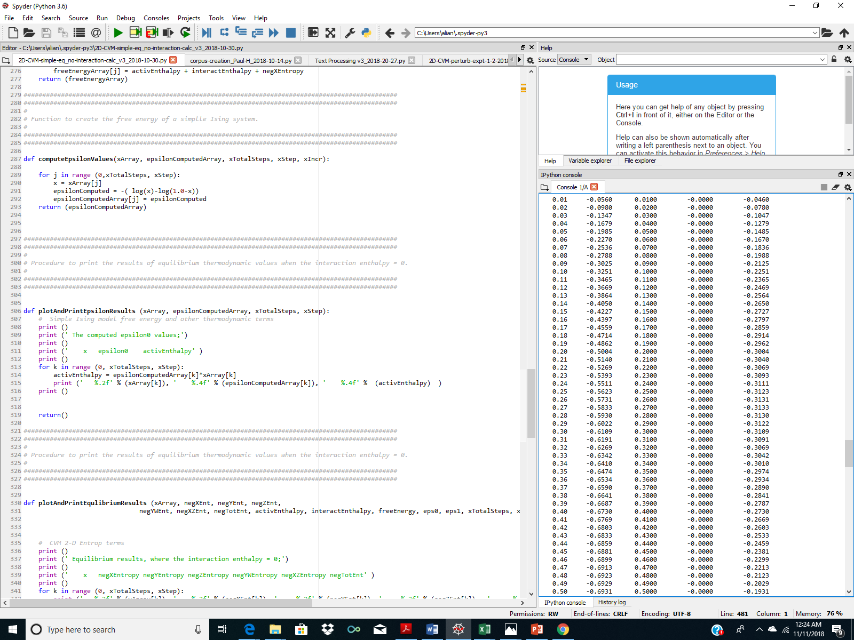
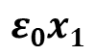
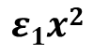
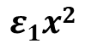
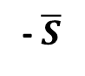
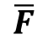
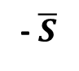
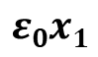
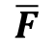
Analytic Run: Compute free energy for a single case
Case 1: eps0 = 1.0, eps1 = 0.0
eps0 = 1.0 => activation enthalpy is non-zero; x₁ < x₂
eps1 = 0.0 => interaction enthalpy is zero; the distribution of configuration variables (y, w, and z) will be probabilistically determined
Free energy minimum for different values for different values of x₁ (eps0 = 1.0)
Yields minimum FE when x₁ = 0.27
x₁
- $\overline{S}$
$$ε0x1$$
$$ε1x2$$
$$\overline{F}$$
x₁
- $\overline{S}$
$$ε0x1$$
$$ε1x2$$
$$\overline{F}$$

Slide 37
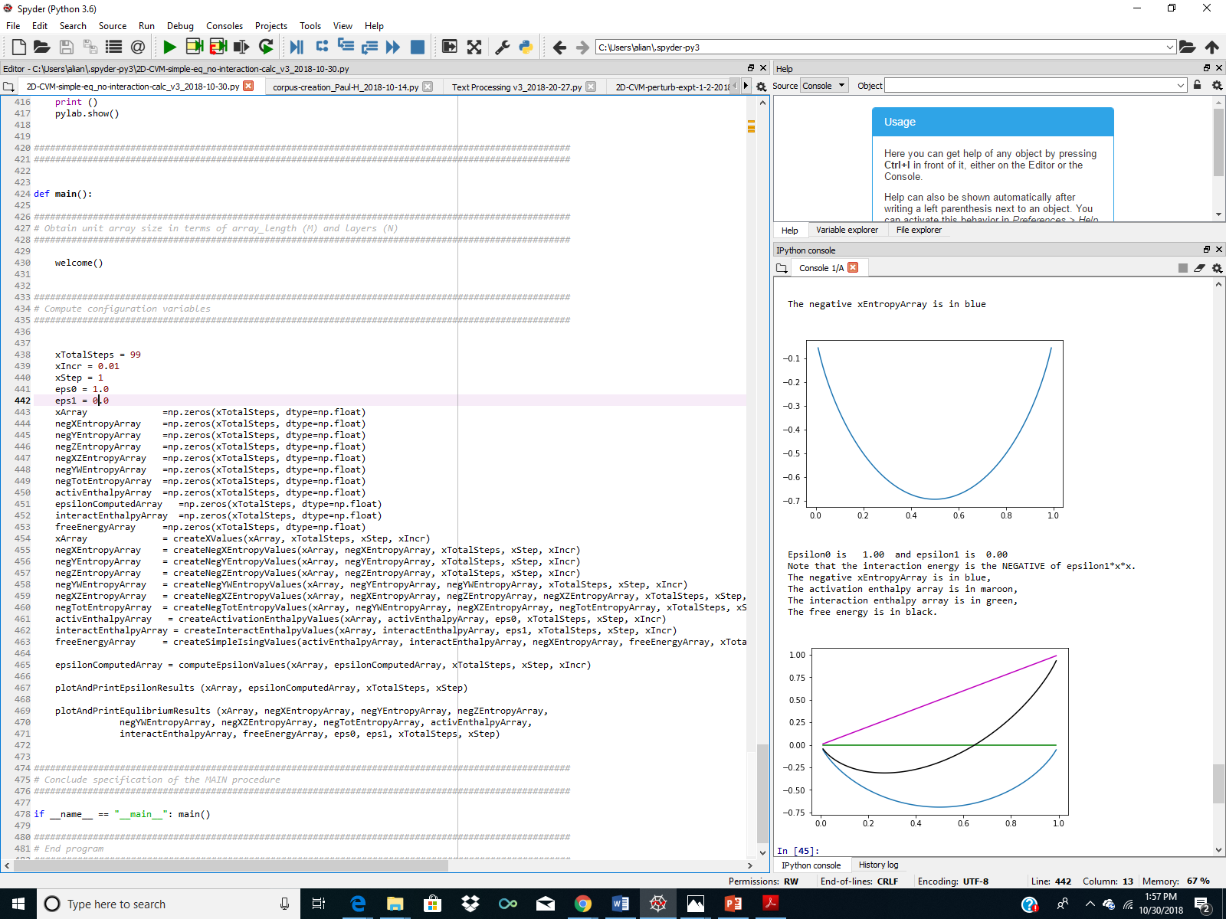
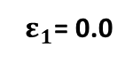
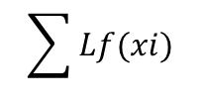
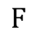
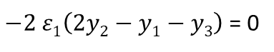
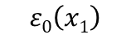
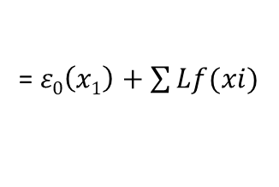
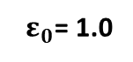
Analytic Result Example: eps0 = 1.0, eps1 = 0.0
The free energy minimum occurs where expected for a given epsilon0 value
(a)
$$ε0\left(x1\right)$$
(b)
$−2 ε1\left(2y2−y1−y3\right)$ = 0
(c)
$$\sum{Lf(xi)}$$
(d)
$$F$$
= $ε0\left(x1\right)+\sum{Lf(xi)}$
Free Energy Minimum
x₁ = 0.27
F = -0.313
a
b
d
c
x1
${ ε}_{0}$= 1.0
For h = 1.0:
(See this point on the next graph)
${ ε}_{1}$= 0.0
x₁ = 0.269

Slide 38

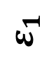
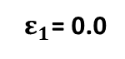
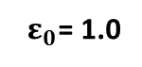
This Gives Us A New Point in the Phase Space
For the case where epsilon1 = 0 (no interaction enthalpy), we are working across the top axis of this graph.
We solve for each value of x1 computationally, as a result of setting the derivative of the free energy equal to zero for a given value of the activation enthalpy eps0.
$${ ε}_{0}$$
0.0
1.0
2.0
3.0
4.0
5.0
x₁
0.500
0.269
0.119
0.047
0.018
0.007
h is the Activation Enthalpy Parameter; h = exp(2.0*eps0)
0.0
0.1
0.500
${ ε}_{0}$= 1.0
(See this point on the previous graph)
For h = 1.0:
0.500
${ ε}_{1}$= 0.0
0.2
x₁ = 0.269
(Interaction Enthalpy Parameter)
FE = -0.313
0.3
0.500
0.4
0.500
$${ ε}_{1}$$
0.5
0.500

Slide 39
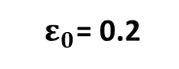
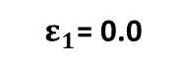
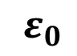
Analytic Values for Active Nodes x₁
Interaction enthalpy is zero:
${ ε}_{1}$= 0
Case 2: Find the eps0 value close to yielding x1 = 0.45
x₁ vs (Activation Enthalpy Parameter)
0.5
$${ ε}_{0}$$
0.4
x₁
0.3
0.2
0.1
0.0
0.0
1.0
0.2
3.0
4.0
5.0
(Activation Enthalpy Parameter)
$${ ε}_{0}$$
For:
${ ε}_{0}$= 0.2
${ ε}_{1}$= 0.0
x₁ = 0.45 (approx)
Code: 2D-CVM-simple-eq_no-interaction-calc_v3_2018-10-30.py

Slide 40
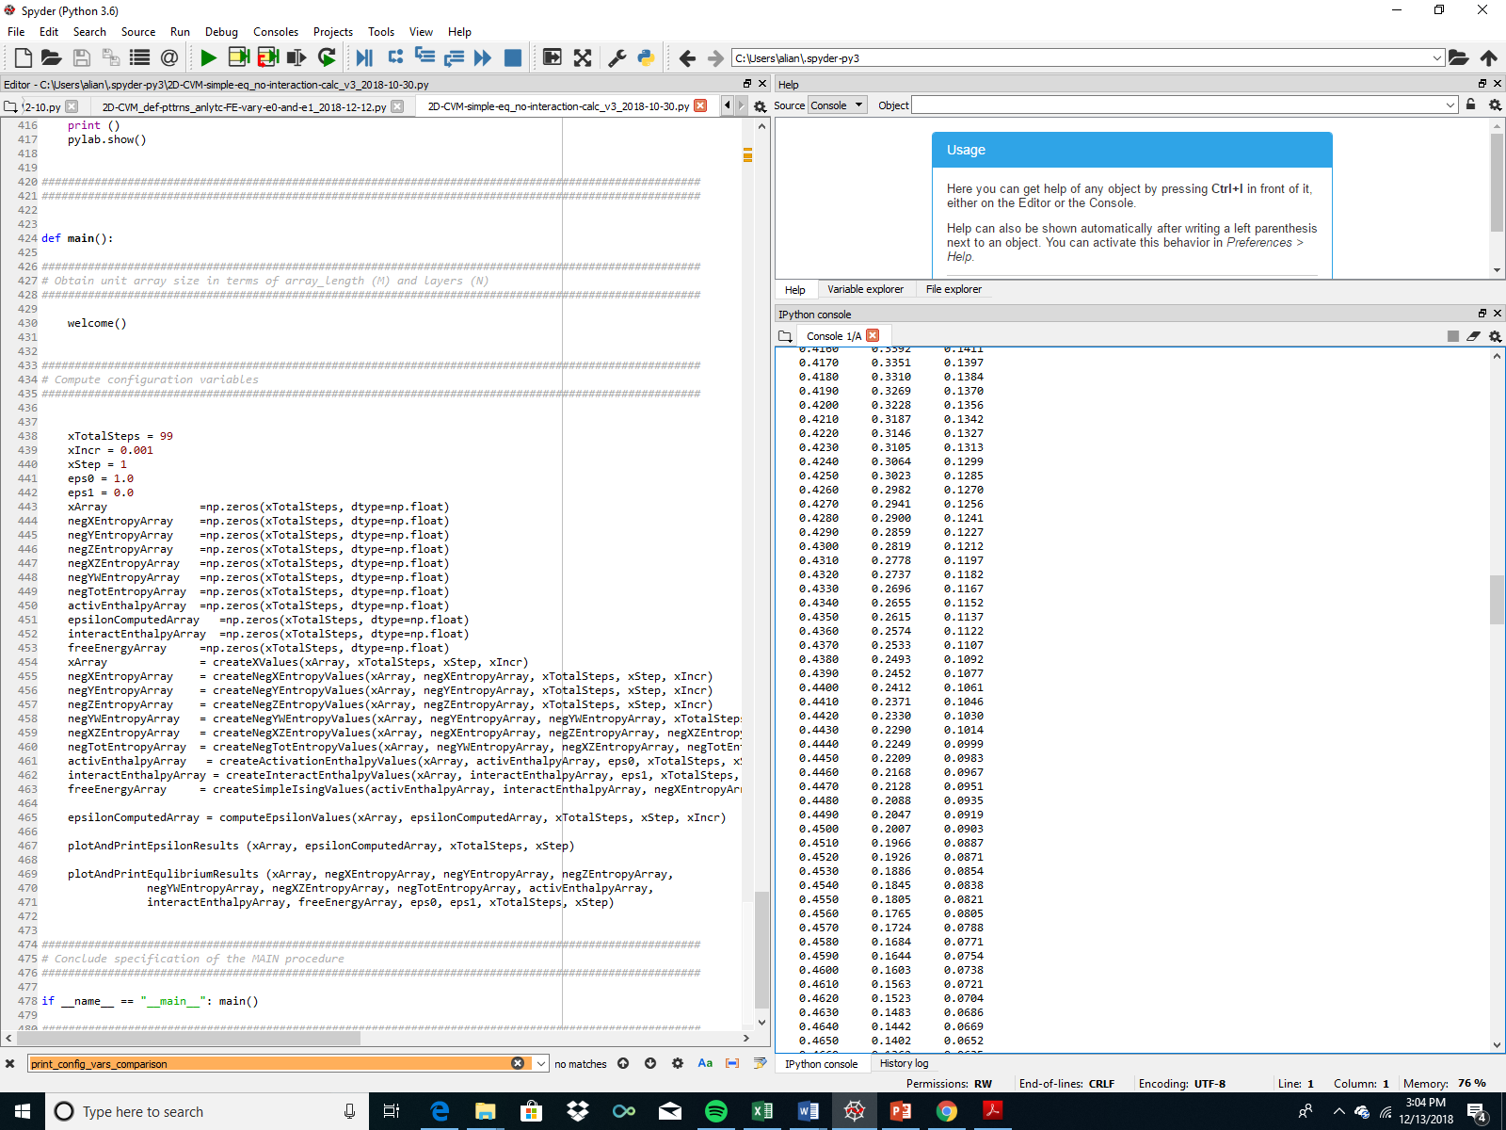
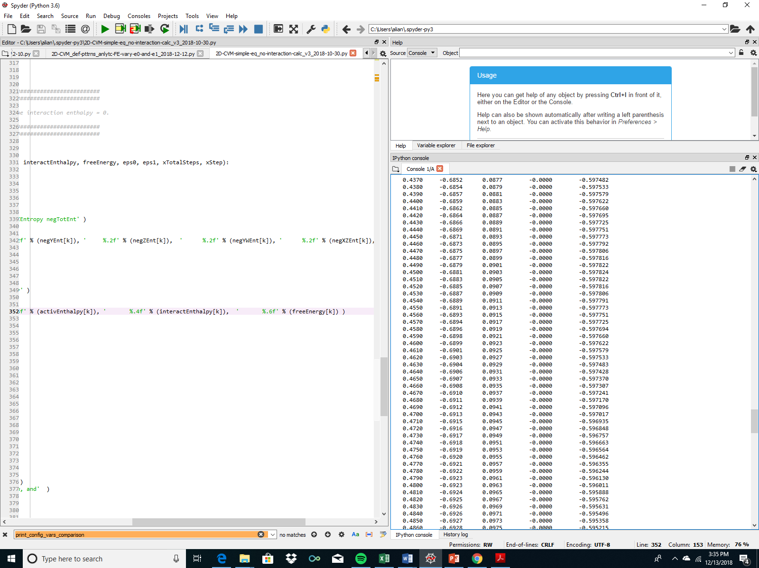
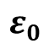
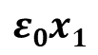
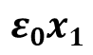
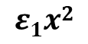
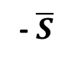

Analytic Run:
Case 2: Compute free energy for case where x1 = 0.45
Free energy minimum for different values for different values of x1 (eps0 = 0.2007)
Step 1: Solve for the eps0 value that yields x1 = 0.45 (LHS)
Step 2: Use that value of eps0 (here, 0.2007) to find the free energy (FE) for that value of x1.
Step 1:
Step 2:
x₁
$$ε0$$
$$ε0x1$$
x₁
- $\overline{S}$
$$ε0x1$$
$$ε1x2$$
$$\overline{F}$$
Code: 2D-CVM-simple-eq_no-interaction-calc_v3_2018-10-30.py
Note: Substitute 0.2007 for the value of epsilon0 (see column, LHS, into the program (line 441) to obtain the results on the right

Slide 41



Illustrating Three Points on the eps0 Variation Axis
For the case where epsilon0 varies, we are working across the top axis of this graph.
We solve for each value of x₁ computationally, as a result of setting the derivative of the free energy equal to zero for a given value of the activation enthalpy eps0.
$${ ε}_{0}$$
(Activation Enthalpy Parameter)
0.0
1.0
2.0
3.0
4.0
5.0
x₁
0.500
0.269
0.119
0.047
0.018
0.007
0.0
1
2
3
0.1
0.500
1
For eps0 = 0 and h = 1.0:
x₁ = 0.500; FE = -0.697
${ ε}_{1}$= 0.0
0.2
0.500
(Interaction Enthalpy Parameter)
2
For eps0 = 0.2007 and h = 1.0:
${ ε}_{1}$= 0.0
x₁ = 0.450; FE = -0.598
0.3
0.500
3
For eps0 = 1.0 and h = 1.0:
${ ε}_{1}$= 0.0
x₁ = 0.269; FE = -0.313
0.4
0.500
$${ ε}_{1}$$
0.5
0.500

Slide 42
The Next Step:
Confirm that the Model with Randomly-Generated Nodes Yielding Desired x₁ Also Yields the Same Free Energy at Analytically-Computed Results with Same Values for Epsilon0 and Epsilon1
Program Used:
2D-CVM_def-pttrns_anlytc-FE-vary-e0-and-e1_2018-12-12.py
Runs made on Dec. 27, 2018

Slide 43


Illustrating The Upper Left-Hand Corner Point on the Phase Space:
eps0 = 0, eps1 = 0 (h = 1)
1
Code: 2D-CVM_def-pttrns_anlytc-FE-vary-e0-and-e1_2018-12-12.py

Slide 44
Important Note about the Following Results:
MODIFY THIS EXPLANATION – address the entropy
Note that in the following slide, the FE Minimum shows as being greater when the h-value (epsilon1) is increased.
This does not mean that the correct FE Minimum is found with any of those larger h-values.
The reason is that the system has not been allowed to come to equilibrium for any of those larger h-values. The grid used to generate these values was adjusted to create the desired A:B node ratio (to get the desired x₁ value).
If we wanted to find the influence of having a non-zero epsilon1 (an h-value > 1) on the system, we would need a second step that swapped different nodes to achieve a set of nearest-neighbors and other configuration variables yielding a minimal FE for a specific h-value.
Getting a non-zero interaction enthalpy here is simply the result of how the grid was randomly generated. It doesn’t really mean a thing.

Slide 45






Confirmation Run: Compute free energy for case where x₁ = 0.45
Randomly-generated unit array
Free energy minimum for different values for different values of x1 (eps0 = 0.2000)
x₁
- $\overline{S}$
$$ε0x1$$
$$ε1x2$$
$$\overline{F}$$
Note: not true system free energy minima
2
FE approx. the same as analytic result of -0.598
Note: Differences in free energy from computational code vs. results from a specific, randomly-generated grid are due to:
Differences in actual x₁ values; the randomly-generated grid has x₁ = 0.4531, and
Epsilon0 for the computational code = 0.2007; for the randomly-generated array it is 0.2000.
Code: 2D-CVM_random-patterns_analytic-solution_2018-12-10.py
Note: Identify x1_target = 0.45, and be sure that the eps0 values cover eps0 = 0.2007

Slide 46
Second Run, Same Criteria, Similar Results
Note that since these runs are made using randomly-generated grids, with the only constraint being that x₁ comes close to a desired value, the specific values for the computed thermodynamic quantities may have small differences; it’s a result of slightly different x₁ values.

Slide 47


Second Illustration of Same Point on the
eps0-variation Axis: x1_target = 0.45
2
Code: 2D-CVM_def-pttrns_anlytc-FE-vary-e0-and-e1_2018-12-12.py

Slide 48
The Left-Hand-Side Axis: Variations in Epsilon1
Illustration of Grid Patterns in the 2-D CVM
Note: Approximate; Counts only Horizontal Triplets

Slide 49

Illustrating a Point on the
eps0 = 0, eps1-variation Axis
For the case where epsilon0 = 0 (no activation enthalpy), we have an analytic solution. (See Kikuchi & Brush, 1967, as well as the same derivation by Maren.)
We set x₁ = x₂ = 0.5, and find the values of the other configuration variables analytically, according to the h-value. The work on the left is a computational check on those results. For the case where eps0 = 0, as is needed for the analytic solution, we expect the lowest free energy to occur when eps1 = 0 as well.
This is because this particular code is run using a random generation of units, with only the relative probability of occurrence being governed by eps0, which in this case is 0.
There is no “swapping” of A and B nodes to create different local configurations, as would be indicated by a different eps1 value.
For this case, the enthalpy is strictly a function of the interaction enthalpy parameter eps1. The term that eps1 multiplies is approximately zero. As eps1 increases, it is possible for the interaction enthalpy to also increase, simply because eps1 is a scalar multiplying the delta in y’s, that is,
Int-enth = 2*eps1*(2*y₂ – y₁ – y₃)
Code: 2D-CVM_def-pttrns_anlytc-FE-vary-e0-and-e1_2018-12-12.py

Slide 50



Illustrating a Point on the eps0 = 0, eps1 Variation Axis
For the case where epsilon0 = 0 (no activation enthalpy), we are working down the left-hand-side vertical axis of this graph.
We solve for each value of x1 computationally, as a result of setting the derivative of the free energy equal to zero for a given value of the activation enthalpy eps0.
$${ ε}_{0}$$
(Activation Enthalpy Parameter)
0.0
1.0
2.0
3.0
4.0
x₁
0.500
0.269
0.119
0.047
0.018
0.0
1
0.1
0.500
1
For eps0 = 0 and h = 1.0:
${ ε}_{1}$= 0.0
x₁ = 0.500; FE = -0.697
0.2
0.500
(Interaction Enthalpy Parameter)
We want to fill in values along this vertical axis
0.3
0.500
0.4
0.500
$${ ε}_{1}$$
0.5
0.500

Slide 51
Recall Previous Analytic Results:
Analytic Values for Configuration Variables y₂, z₁, and z₃
Scale-Free-Like
Extreme Rich Club-Like and Scale-Free-Like Patterns
B
A
A
For h = 1.16:
Z₃:
Z₁:
y₂:
B
B
A
A
A
A
y₂ = 0.212
A
z₁ = 0.169
Configuration variable
y₂
Scale-Free-Like
z₃ = 0.092
h = 1.16
(ε₁ = 0.074)
z₃
Rich Club-Like
Rich Club-Like
h = 1.65
(ε₁ = 0.250)
z₁
For h = 1.65:
y₂ = 0.047
z₁ = 0.418
Approximate Useful Range for h
z₃ = 0.020
h: interaction enthalpy parameter;
$${ h=exp(2ε}_{1})$$

Slide 52








Our Goal is to Fill in the Phase Space Values
$${ ε}_{0}$$
$${ ε}_{1}$$
Configuration Variables are Functions of and
Values Found at Equilibrium
$${ ε}_{0}$$
$${ ε}_{1}$$
x₁ vs (Activation Enthalpy Parameter) and (Interaction Enthalpy Parameter)
$${ ε}_{0}$$
(Activation Enthalpy Parameter)
x₁
0.0
1.0
2.0
3.0
4.0
5.0
0.0
0.500
0.269
0.119
0.047
0.018
0.007
Scale-Free-Like
We obtained two complete data points (values for x₁, y₂, z₁, and z₃) by manually-generating different patterns (with eps0 = 0, so x₁ = 0.5), counting the configuration variables, and finding the corresponding h-values that yielded those configuration values. Then we located these on the left-hand vertical axis.
0.1
0.500
Rich Club-Like
0.2
0.500
(Interaction Enthalpy Parameter)
${ ε}_{0}$= 0.0
0.3
0.500
For h = 1.16:
${ ε}_{1}$= 0.074
${ ε}_{0}$= 0.0
For h = 1.65:
x₁ = 0.500
${ ε}_{1}$= 0.250
0.4
0.500
$${ ε}_{1}$$
y₂ = 0.212
x₁ = 0.500
0.5
0.500
z₁ = 0.169
y₂ = 0.047
z₃ = 0.092
z₁ = 0.418
z₃ = 0.020

Slide 53
Defining the Phase Space Boundaries
Program Used:
2D-CVM-simple-eq_no-interaction-calc_v2_2018-10-27.py

Slide 54






Our Goal is to Fill in the Phase Space Values
Pragmatically, we only need a portion of the grid
$${ ε}_{0}$$
$${ ε}_{1}$$
x₁ vs (Activation Enthalpy Parameter) and (Interaction Enthalpy Parameter)
$${ ε}_{0}$$
(Activation Enthalpy Parameter)
x₁
0.0
1.0
2.0
3.0
4.0
5.0
0.0
0.500
0.269
0.119
0.047
0.018
0.007
Scale-Free-Like
Useful portion
Useful portion of the grid is bounded by:
0.1
0.500
0.2
0.500
Rich Club-Like
(Interaction Enthalpy Parameter)
${ ε}_{0 }$< 3.0
For h = 1.16:
$ε_{1}$< 0.25
0.3
0.500
${ ε}_{1}$= 0.074
If the activation enthalpy is too large, then x₁ becomes too small, and we risk not having sufficient numbers of the z₁ triplets.
0.4
0.500
${ ε}_{0 }$:
For h = 1.65:
$${ ε}_{1}$$
${ ε}_{1}$= 0.250
0.5
0.500
If the interaction enthalpy is too large, then we’ve already pushed the system to a single, maximally-sized cluster of each type, and there is no benefit to increasing the interaction enthalpy.
${ ε}_{1 }$:
Two extreme topography types

Slide 55
Next Steps
Fill in the grid values by obtaining configuration variable sets where the free energy is minimized for given pairs of non-zero enthalpy parameters.
Non-trivial, as the parameters interact with the configuration variables producing the free energy minimum. Computational solutions will be needed.
$${ ε}_{0}$$
(Activation Enthalpy Parameter)
x₁
0.0
1.0
2.0
3.0
4.0
5.0
0.0
0.500
0.269
0.119
0.047
0.018
0.007
0.1
0.500
Fill in this portion of the grid
0.2
0.500
(Interaction Enthalpy Parameter)
0.3
0.500
0.4
0.500
$${ ε}_{1}$$
0.5
0.500

Slide 56
Experimental Trial #1:
Slightly Smaller Rich Club
Programs Used:
2D-CVM_def-pttrns_anlytc-FE-vary-e0-and-e1_2018-12-12.py
Repository:
https://github.com/ajmaren/2-D-CVM-Defined-Pattern-Configurations

Slide 57
For Reference: An Extreme Rich Club-Like Composition: Code Validation
z₁ = Z₁/(2xN) = 214/(512) = 0.4180
z₃ = Z₃/(2xN) = 10/(512) = 0.0195
Hand-counted z₁ and z₃ values:
Code validation step
Approximate h-value: 1.65
NOTE: Hand-crafted pattern has equal values for z₁ & z₆, etc., so the h-value corresponds to the hand-counts. However: the analytic solution diverges as h gets larger.
Program: 2D-CVM_defined-patterns_analytic-solution_2017-12-08_rev_2018-11-22.py
Run Date: 11/23/2018 Private GitHub: 2-D-CVM-Random-Pattern-Configurations

Slide 58




Illustration of Grid Computation for the
First Rich Club Pattern: x1_target = 0.50
${ ε}_{0}$= 0.0
For h = 1.65:
${ ε}_{1}$= 0.250
x₁ = 0.500
y₂ = 0.047
z₁ = 0.418
z₃ = 0.020
Note: We can continue to decrease the FE by increasing interaction enthalpy parameter eps1; it linearly increases the negative value of the interaction enthalpy. However, it doesn’t SOLVE for a FE minimum.

Slide 59
Experimental Trial #2:
Small Concave Region (“Small Rich Club”)
Programs Used:
2D-CVM_def-pttrns_anlytc-FE-vary-e0-and-e1_2018-12-12.py
Repository:
https://github.com/ajmaren/2-D-CVM-Defined-Pattern-Configurations

Slide 60
Experimental Specification:
Functionality:
This code still has the old “random pattern” capabilities in it, but is used for defined pattern experiments
Pattern 3 is a tightly convex (circle) of 30 A nodes in a sea of B
30 A nodes gives 30/256 = x₁ = 0.119 (actually, 30.464 nodes)
The corresponding case (with eps1 = 0) would have eps0 = 2.0 (see next slide)
Thus, when we run the thermodynamics, we should get the free energy minimum when eps0 is close to 2.0
And the eps1 should be in the neighborhood of 0.256 (h = exp(2*beta*eps1; per Kikuchi-Brush 1967, and beta=1, so h = exp(0.512) = 1.669)
Code Source and Documentation:
GitHub Private Repository:
https://github.com/ajmaren/2-D-CVM-Defined-Pattern-Configurations
Code:
2D-CVM_def-pttrns_anlytc-FE-vary-e0-and-e1_2018-12-12.py
Documentation:
TBD

Slide 61


This Gives Us A New Point in the Phase Space
For the case where epsilon1 = 0 (no interaction enthalpy), we are working across the top axis of this graph.
We solve for each value of x1 computationally, as a result of setting the derivative of the free energy equal to zero for a given value of the activation enthalpy eps0.
$${ ε}_{0}$$
0.0
1.0
2.0
3.0
4.0
5.0
x₁
0.500
0.269
0.119
0.047
0.018
0.007
h is the Activation Enthalpy Parameter; h = exp(2.0*eps0)
0.0
We know this point:
${ ε}_{0}$= 1.0
0.1
0.500
For h = 1.0:
${ ε}_{1}$= 0.0
x₁ = 0.269
0.2
0.500
We want this point:
(location in phase space unknown)
(Interaction Enthalpy Parameter)
FE = -0.313
0.3
0.500
0.4
0.500
$${ ε}_{1}$$
0.5
0.500

Slide 62
Experimental Specification: Very Small Rich Club
Create a small cluster of “A” nodes in a sea of “B,” and computationally identify the (eps0, eps1) values that yield the free energy minimum associated with this pattern.
x₁ vs epsilon₀ (Activation Enthalpy Parameter) and epsilon₁ (Interaction Enthalpy Parameter)
epsilon₀ (Activation Enthalpy Parameter)
0.0
1.0
2.0
3.0
4.0
5.0
x₁
0.500
0.269
0.119
0.047
0.018
0.007
0.0
Starting Experimental Specifications:
Eps0 = 2.0 => x1_target = 0.119
X1_actual (defined pattern) = 0.119*256 = 30.46
Or X1_actual => 30
=> Generate a pattern where X₁ = 30
Expected values for FE minimum:
eps0 near 2.0
eps1 near 0.25, or h near 1.65
However: We don’t know exactly which values for (eps0, eps1) will produce a free energy minimum for this specified pattern
0.1
0.500
We want to position a point approximately here:
0.2
0.500
epsilon₁ (Interaction Enthalpy Parameter)
0.3
0.500
0.4
0.500
0.5
0.500

Slide 63
A “rich club” of only 30 “A” Nodes; all connected
A Very Small Rich Club:
= 30 “A” (all connected)
and 226 “B” (connected)
Row 15*
*wrap-around
Row 0
Configuration Variables
Row 1
Horizontal Triplets | Z₁ | Z₃
A = black; B = white Counts for EACH row | A / \ A A | B / \ A A
Row 0 to Row 1 Row 14 to Row 15 | (0+0=0) *2 = 0 | (0+0=2)*2 = 0
Row 1 to Row 2 Row 13 to Row 14 | (0+0=0) *2 = 0 | (0+0=0)*2 = 0
Row 2 to Row 3 Row 12 to Row 13 | (0+0=0) *2 = 0 | (0+0=0)*2 = 0
Row 3 to Row 4 Row 11 to Row 12 | (0+0=0) *2 = 0 | (0+0=0)*2 = 0
Row 4 to Row 5 Row 10 to Row 11 | (0+0=0) *2 = 0 | (0+2=2)*2 = 4
Row 5 to Row 6 Row 9 to Row 10 | (2+3=5) *2 = 10 | (0+1=1)*2 = 2
Row 6 to Row 7 Row 8 to Row 9 | (4+5=9) *2 = 18 | (0+1=1)*2 = 2
Row 7 to Row 8 Row 15 to Row 0 | 6+6=12 0+0 = 0 | 0+0=0 0+0 = 0
Sum | 40 | 8
Row 2
Row 3
Row 4
Row 5
Row 6
Row 7
Row 8
Row 9
Row 10
Row 11
Row 12
Row 13
Row 14
Row 15
Illustration based on counting the horizontal triplets only:
z₁ = Z₁/(2xN) = 38/(512) = 0.742
z₃ = Z₃/(2xN) = 8/(512) = 0.0156

Slide 64

Experimental Configurations for variable (eps0, eps1): Trial #1
“Very Small Rich Club”
Repository (Private):
Code: 2D-CVM_def-pttrns_anlytc-FE-vary-e0-and-e1_2018-12-12.py
Pattern: 3
Check that hand-computed z values match the code-computed ones
Hand-computed configuration values:
Z1 = 40; z1 = 40/512 = 0.0781; matches
Z3 = 8; z3 = 8/512 = 0.0156; matches.
Next step: Find the (eps0, eps1) pair yielding a free energy minimum for this grid pattern

Slide 65
The Challenge:
What does not work: Simply creating a defined pattern and running a set of free energy computations, with different values of epsilon0 and epsilon1, won’t work
What can possibly work:
Creating a “base pattern” as a starting point, and identifying candidate epsilon0 and epsilon1 values that we think might generate a minimal FE for that pattern
Hold the epsilon values constant
Modify the pattern (via node-swaps) until a FE minimum IS reached
Assess the resulting configuration variables
Do this several times and assess / average the results
This requires fairly complex code, which will be addressed in the next slidedeck

Slide 66
An Example Starting Point for Finding the Next Set of Data Points
Row 15*
*wrap-around
A Slightly Smaller Rich Club-Like Composition:
x1_target = 0.45
= 115 “A” (all connected)
and 141 “B” (connected)
(Note: 0.45*256 = 115.2)
Original configuration had 128 “A” nodes; so convert 13 of these to “B”
Row 0
Row 1
Row 2
Row 3
Row 4
Row 5
Row 6
Expected eps0 approx. 0.2
Expected eps1 approx. 1.65
Row 7
Row 8
We would postulate these values for the epsilons, and computationally achieve a true FE minimum:
Change x1:x2 ratio, slightly, and then
Vary the locations of “A” and “B” nodes (node-swapping) until FE minimum was found
Rinse & repeat.
Row 9
Row 10
Row 11
Row 12
Row 13
Row 14
Row 15

Slide 67



Illustration of Grid Computation for the
Slightly Smaller Rich Club Pattern: x1_target = 0.45
${ ε}_{0}$= 0.0
For h = 1.65:
${ ε}_{1}$= 0.250
x₁ = 0.450
y₂ = 0.051
z₁ = 0.367
z₃ = 0.0195
?
Note: We can continue to decrease the FE by increasing interaction enthalpy parameter eps1; it linearly increases the negative value of the interaction enthalpy. However, it doesn’t SOLVE for a FE minimum.

Slide 68
Code Functionality for Specific Codes
Programs Used:
2D-CVM_def-pttrns_anlytc-FE-vary-e0-and-e1_2018-12-12.py
Repository:
https://github.com/ajmaren/2-D-CVM-Defined-Pattern-Configurations

Slide 69
Code Documentation:
GitHub Private Repository:
https://github.com/ajmaren/2-D-CVM-Defined-Pattern-Configurations
Code:
2D-CVM_def-pttrns_anlytc-FE-vary-e0-and-e1_2018-12-12.py
2D-CVM_def-pttrns_anlytc-FE-vary-e0-and-e1_v1pt1_2018-12-29.py
Functionality:
This code still has the old “random pattern” capabilities in it, but is used for defined pattern experiments
Pattern 3 is a tightly convex (circle) of 30 A nodes in a sea of B
30 A nodes gives 30/256 = x1 = 0.119 (actually, 30.464 nodes), which is eps0 = 2.0
Thus, when we run the thermodynamics, we should get the free energy minimum when eps0 is close to 2.0
And the eps1 should be in the neighborhood of 0.256 (h = exp(2*beta*eps1; per Kikuchi-Brush 1967, and beta=1, so h = exp(0.512) = 1.669)
Pattern 4 is a slightly reduced version of Pattern 2; with x1 = 0.45
Results presented here are for Pattern 2, which is the “extreme rich club” with the A nodes on the two sides (and actually connected via the envelope wrap-around both horizontally and vertically).

Slide 70
Code Sources and Documentation
Programs Used:
Various

Slide 71
For More Information:
GitHub Public Repository:
https://github.com/ajmaren/2D-Cluster-Variation-Method
Code for some of this work is still on a private repository
Website:
www.aliannajmaren.com
Code Availability:
Code will be made available on the public GitHub repository after initial development, documentation, V&V, and experiments are completed.
Look on arXiv for various papers documenting theoretical and experimental results. See the “Patents and Publications” page on www.aliannajmaren.com for full access to the latest papers. See the “Blog” page for discussions on theory, code, and experimental results.
Contact Information:
Alianna J. Maren, Ph.D.:
alianna@aliannajmaren.com
alianna.maren@northwestern.edu

